Slide 1
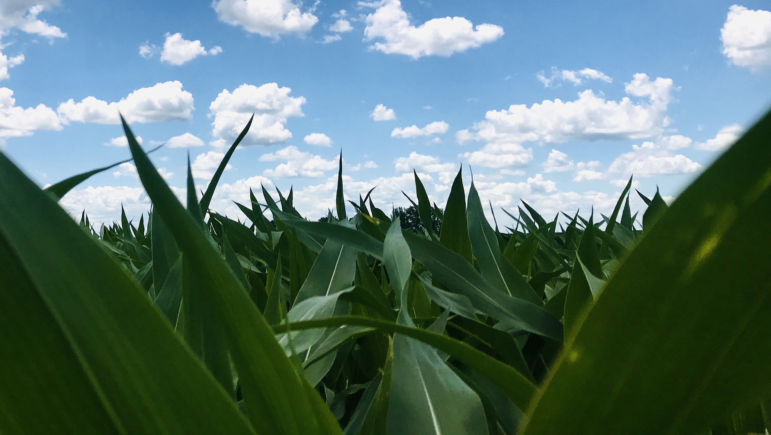
Data Tips, Part 2
Gina Nichols
2020 Fall DataFEWsion Sharing Series

Slide 2
get some data
manuscript, glory, graduation

Slide 3
get some data
manuscript, glory, graduation
Data Creation
collect data

Slide 4

get some data
manuscript, glory, graduation
Data Creation
collect data
enter
data

Slide 5
get some data
manuscript, glory, graduation
Cleaned, QCed, tidy data
formatted
QCed
filtered
Data Creation
collect data
enter
data
wrangle
data

Slide 6
get some data
manuscript, glory, graduation
Cleaned, QCed, tidy data
formatted
QCed
filtered
Data Creation
collect data
enter
data
wrangle
data
Publishable!

Slide 7
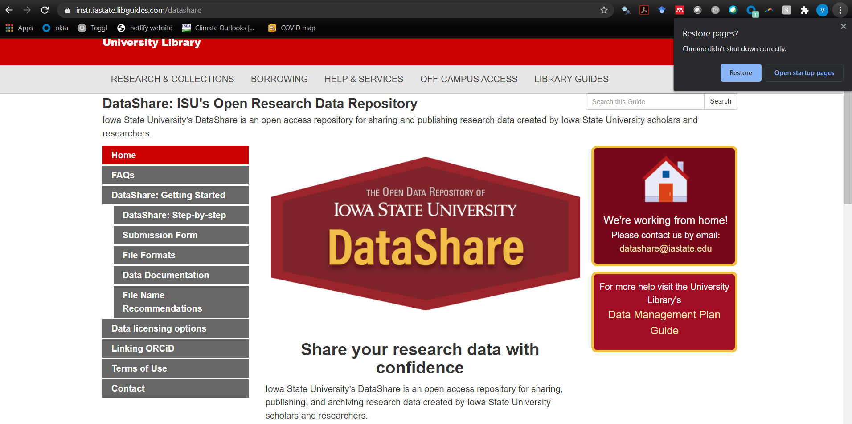
Publishable!

Slide 8
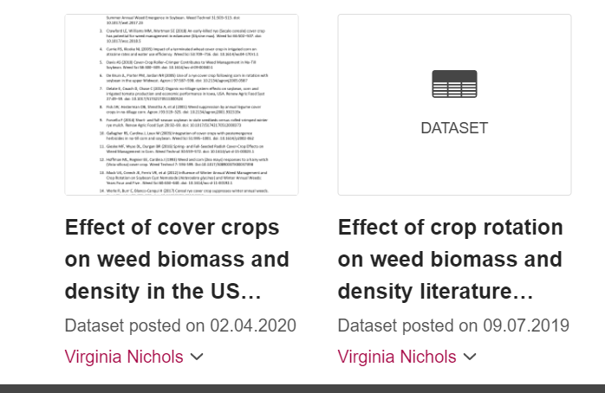
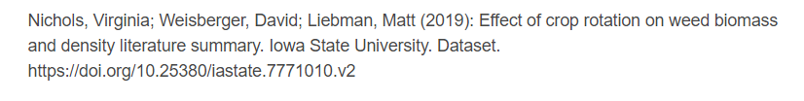
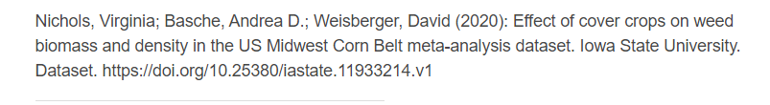
Publishable!

Slide 9
get some data
manuscript, glory, graduation
Cleaned, QCed, tidy data
formatted
QCed
filtered
Data Creation
collect data
enter
data
wrangle
data

Slide 10
get some data
manuscript, glory, graduation
Cleaned, QCed, tidy data
formatted
QCed
filtered
Data Creation
collect data
enter
data
wrangle
data
Summarized data (ex. stats, figures)
Some form of communication about your data (ex. manuscript)
Tidy data
Data Analysis
Analyze data
Contextualize data

Slide 11
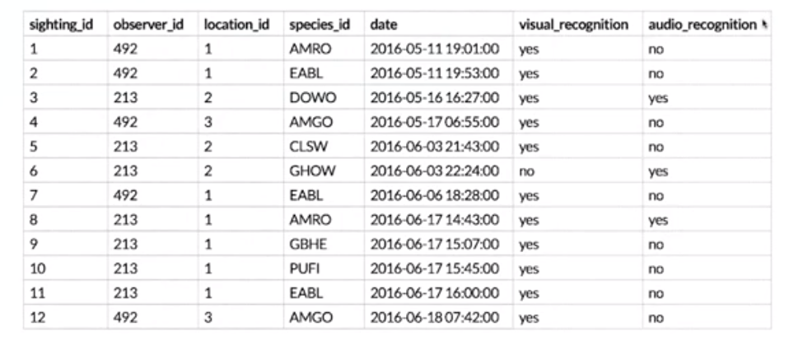
collect data
enter
data
wrangle
data

Slide 12

collect data
enter
data
wrangle
data

Slide 13
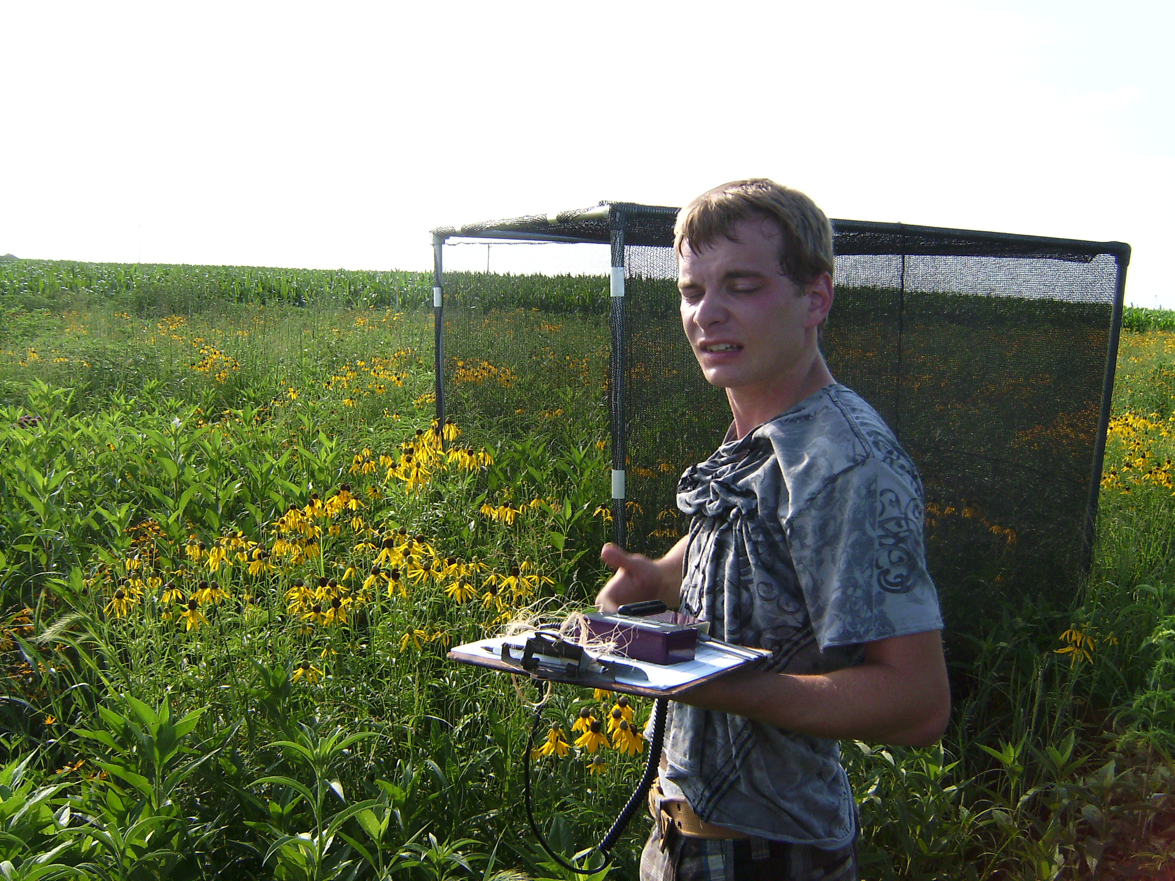
collect data
enter
data
wrangle
data

Slide 14
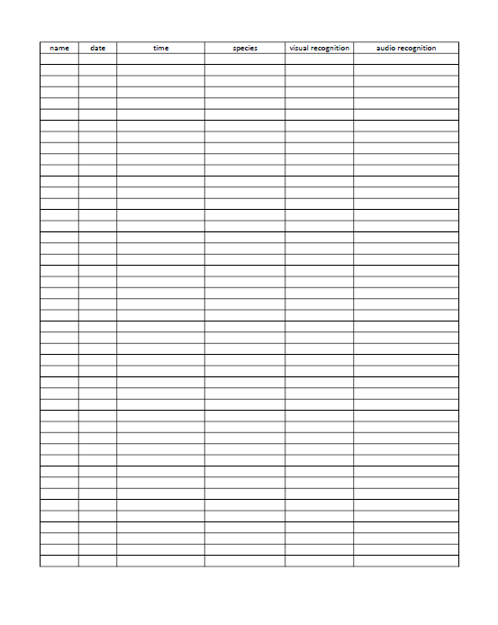

Slide 15
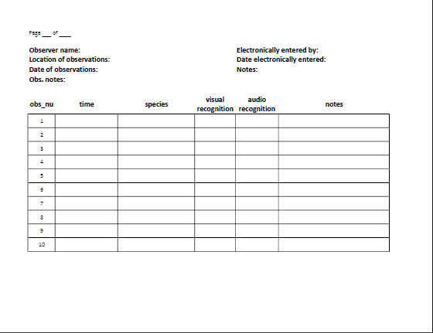

Slide 16
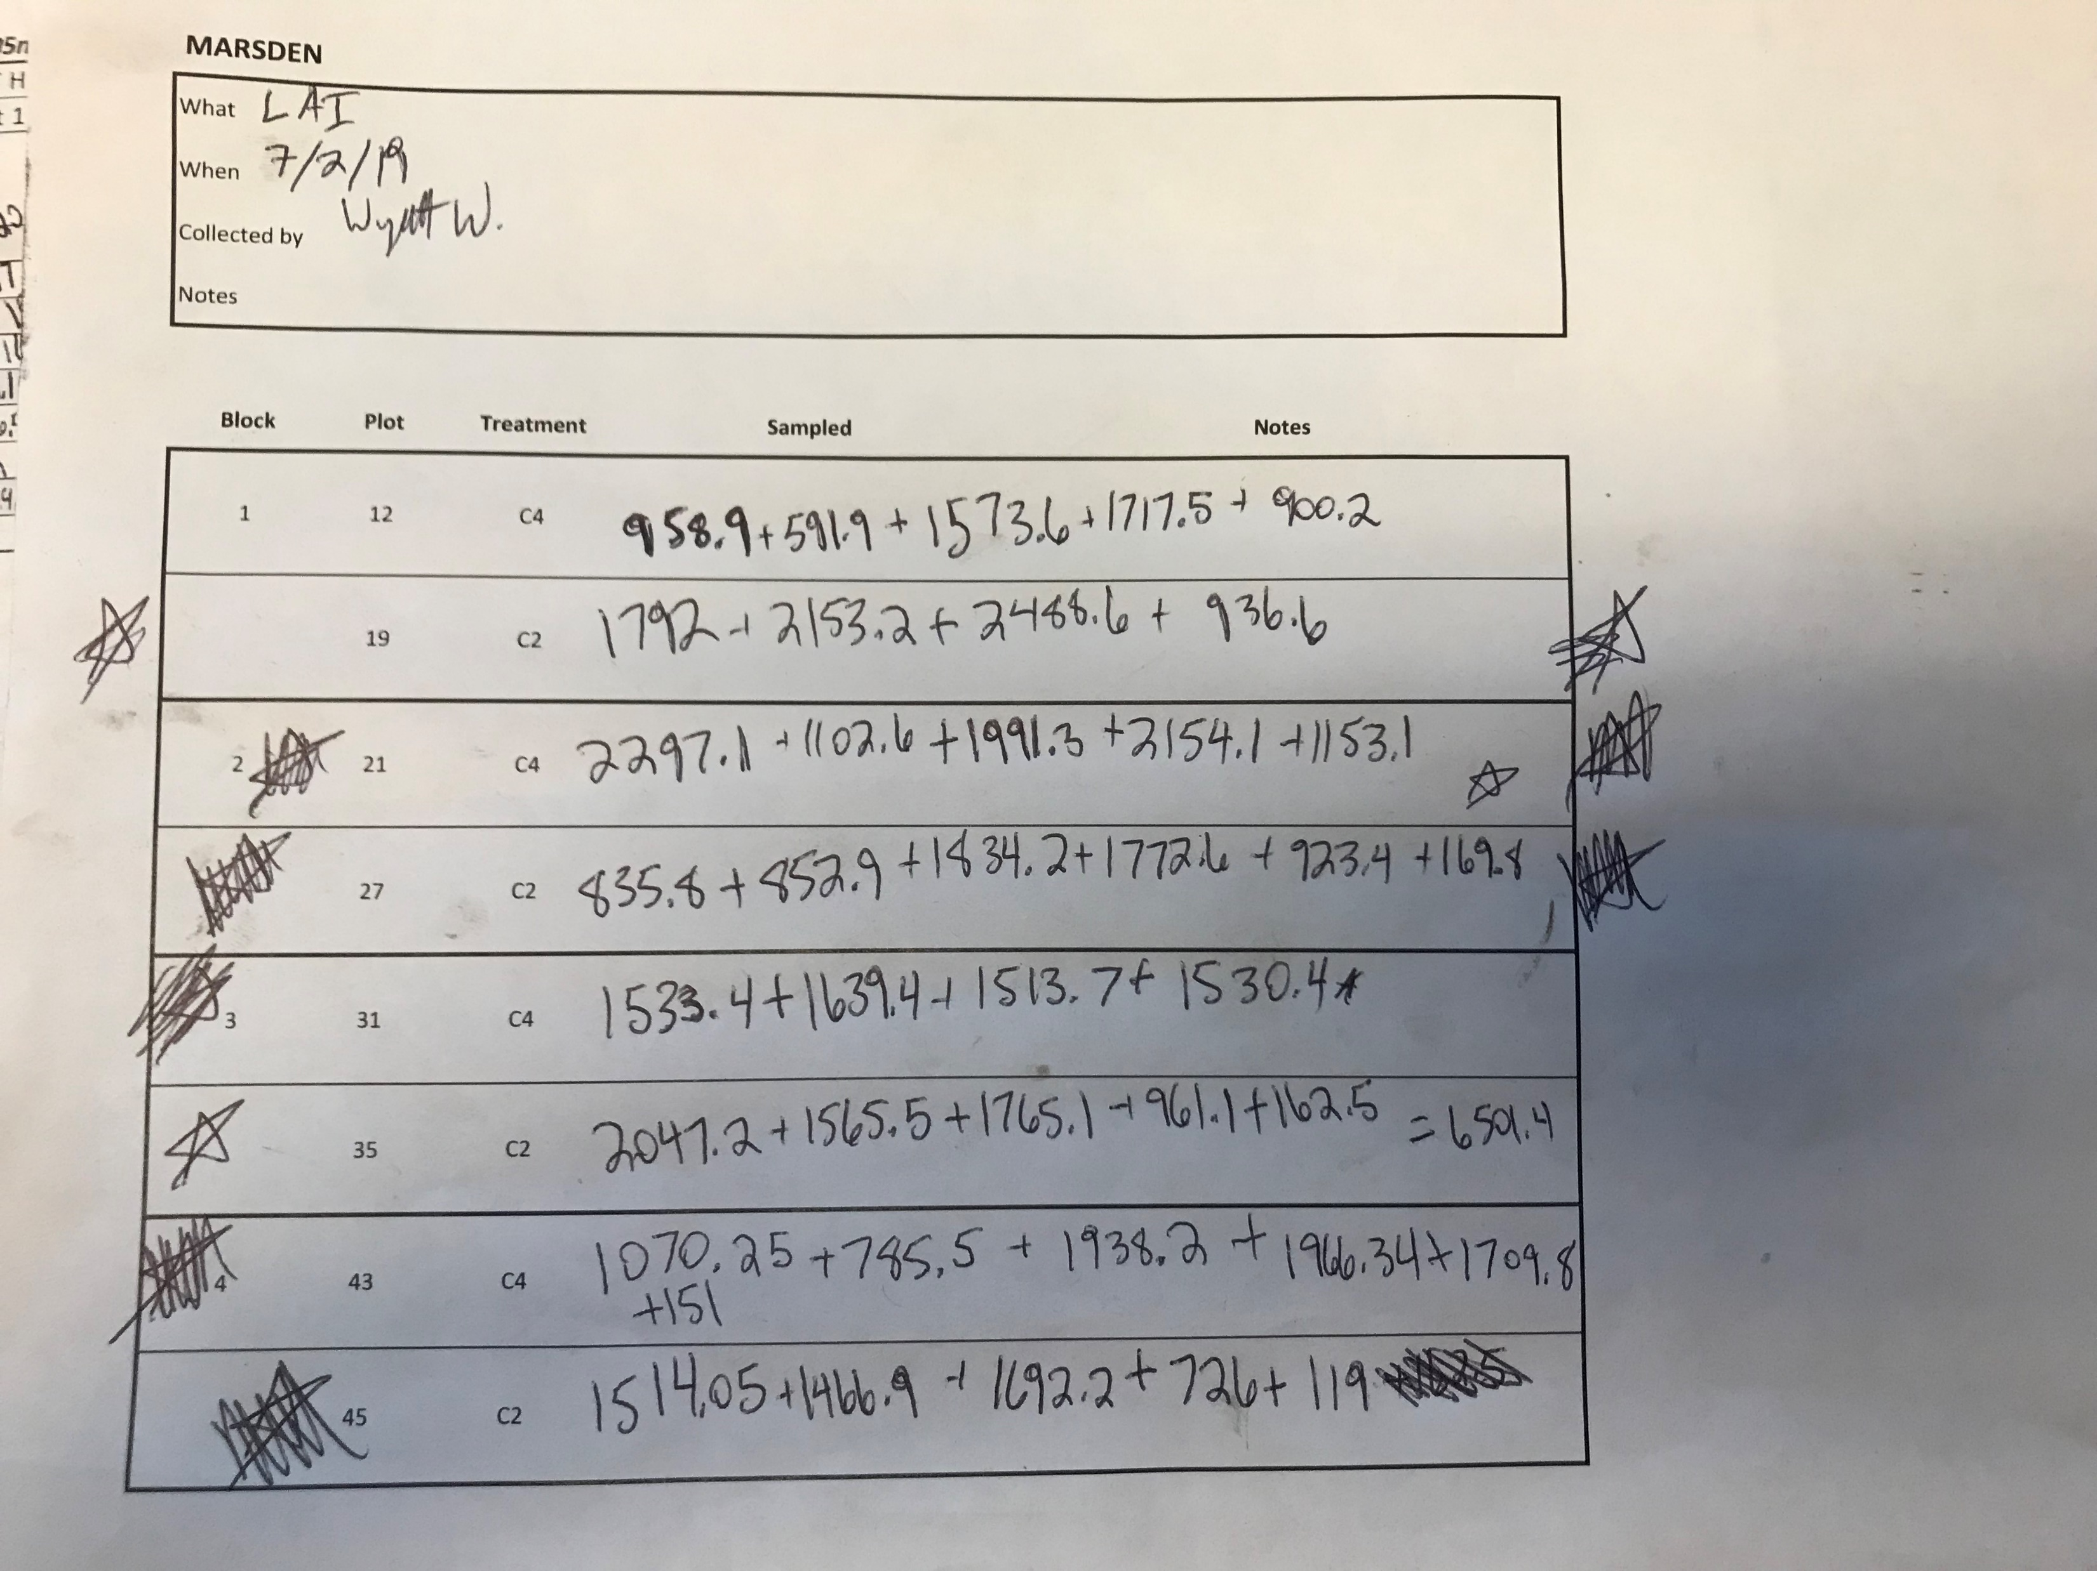
collect data
enter
data
wrangle
data

Slide 17
collect data
enter
data
wrangle
data
Take a picture of the paper data sheet!

Slide 18
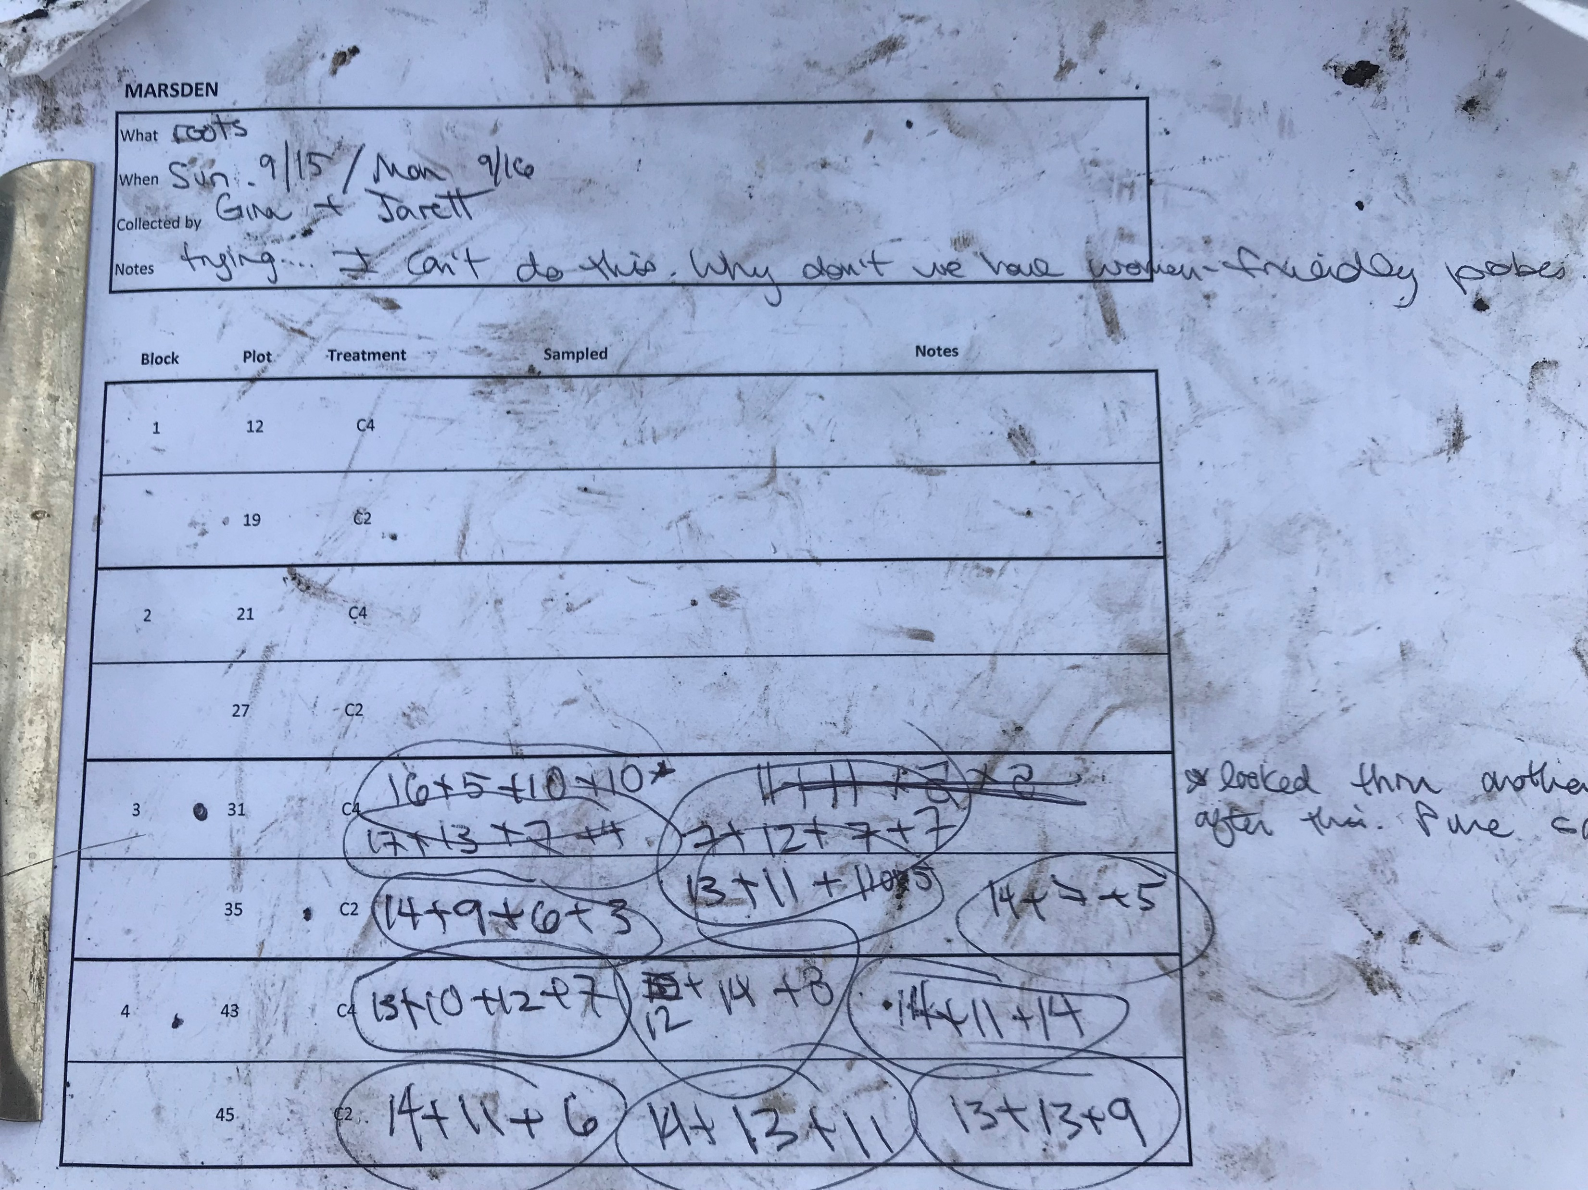
Take a picture of the paper data sheet!
Take a picture of the paper data sheet!

Slide 19
collect data
enter
data
wrangle
data

Slide 20

collect data
enter
data
wrangle
data

Slide 21
collect data
enter
data
wrangle
data

Slide 22
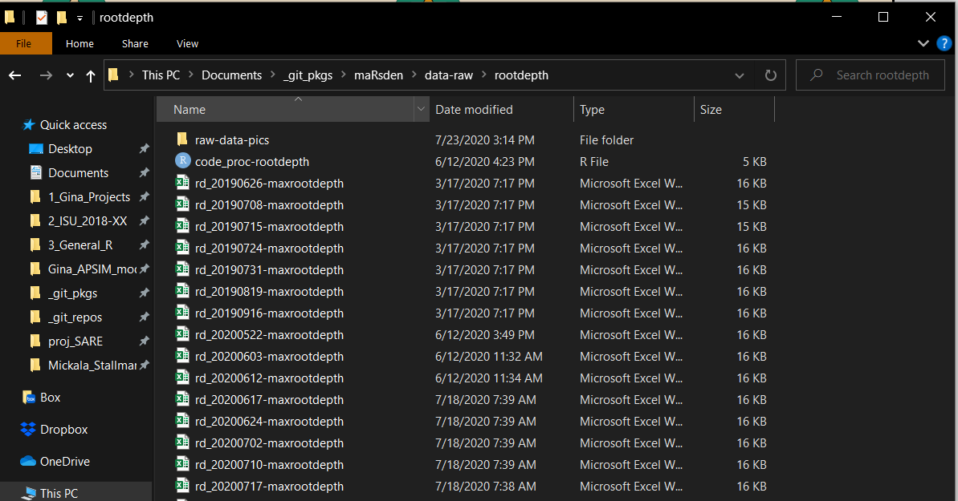
collect data
enter
data
wrangle
data

Slide 23


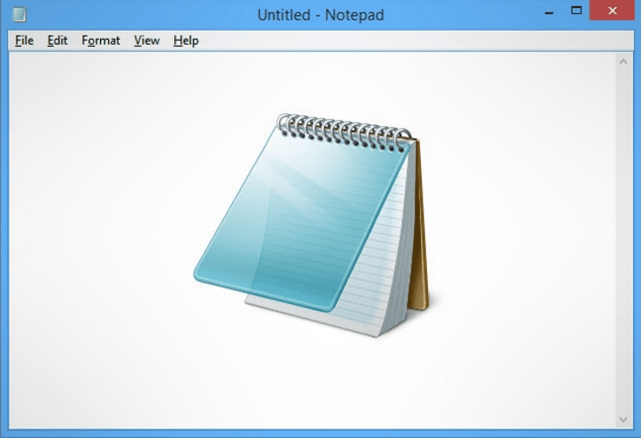
collect data
enter
data
wrangle
data
8/19/1945
Removed obs 59 because machine operator sneezed

Slide 25
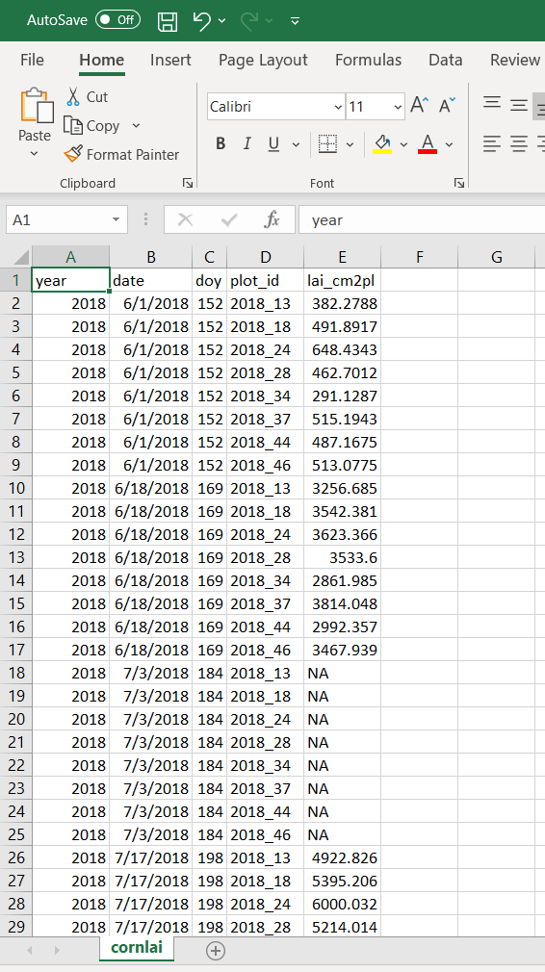

Slide 27
get some data
manuscript, glory, graduation
Paper version of raw data
Electronic version of raw data
Cleaned, QCed, tidy data
formatted
QCed
filtered
Data Creation
collect data
enter
data
wrangle
data

Slide 28
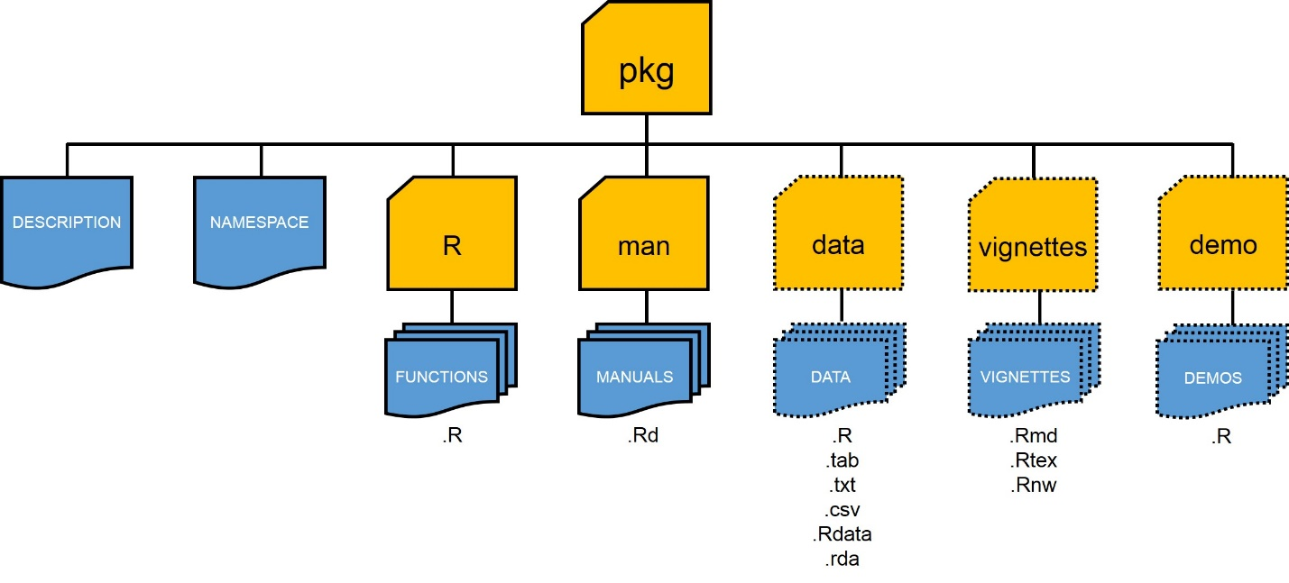
get some data
manuscript, glory, graduation
Paper version of raw data
Electronic version of raw data
Cleaned, QCed, tidy data
formatted
QCed
filtered
Data Creation
collect data
enter
data
wrangle
data

Slide 29
get some data
manuscript, glory, graduation
Paper version of raw data
Electronic version of raw data
Cleaned, QCed, tidy format data
formatted
QCed
filtered
Data Creation
collect data
enter
data
wrangle
data
Summarized data (ex. stats, figures)
Some form of communication about your data (ex. manuscript)
Data Analysis
Give to poor grad student taking up your project
Analyze data
Contextualize data

Slide 30
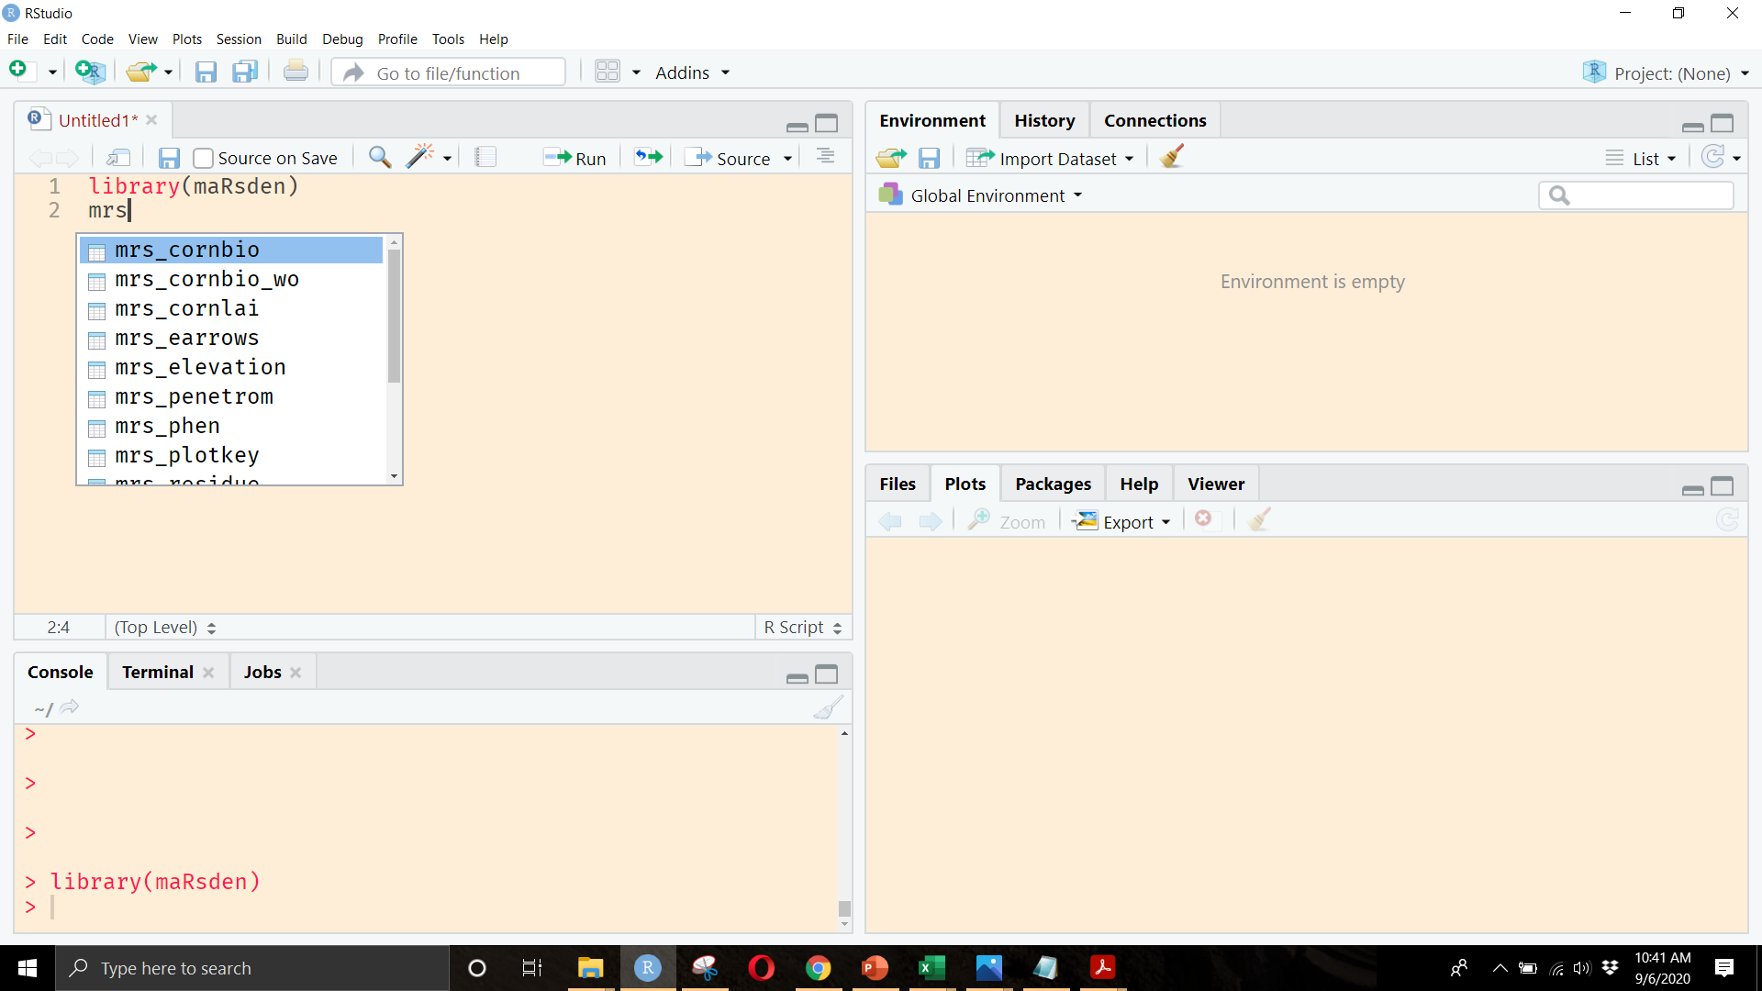
get some data
manuscript, glory, graduation
Paper version of raw data
Electronic version of raw data
Cleaned, QCed, tidy format data
formatted
QCed
filtered
Data Creation
collect data
enter
data
wrangle
data

Slide 31
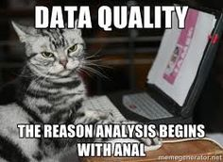
collect data
enter
data
wrangle
data
Separate data collection and data analysis
Consider publishing your data!
Take pictures of paper copy of data
Never touch the raw data
Never touch the raw data
If using Excel, consider learning R, but in the meantime keep a log of differences between raw data and tidy data

Slide 32

40 hours
https://r4ds.had.co.nz/
Stat579 (Intro to R and the tidyverse)
Every fall
Stat585 (More advanced R, R packages)
Odd springs (spring 2021!)
DataFEWSion program…?
DataCamp

Slide 33
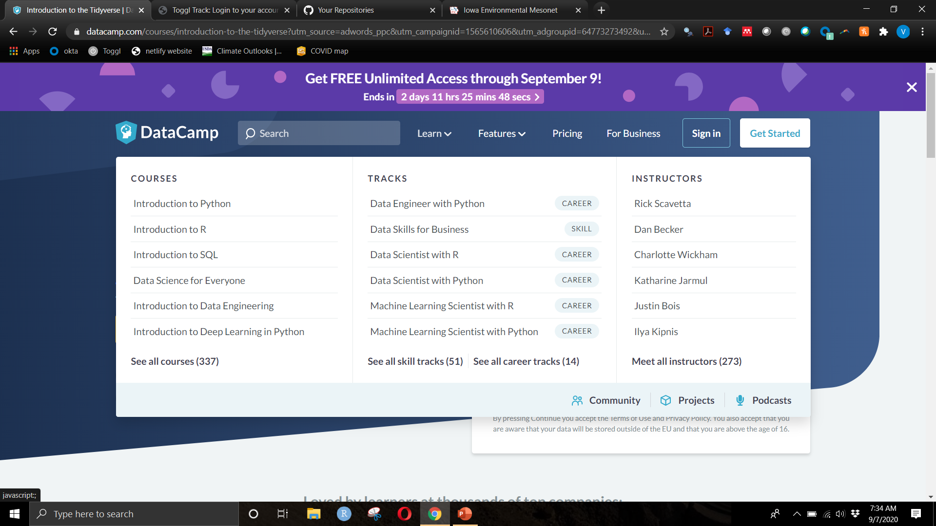
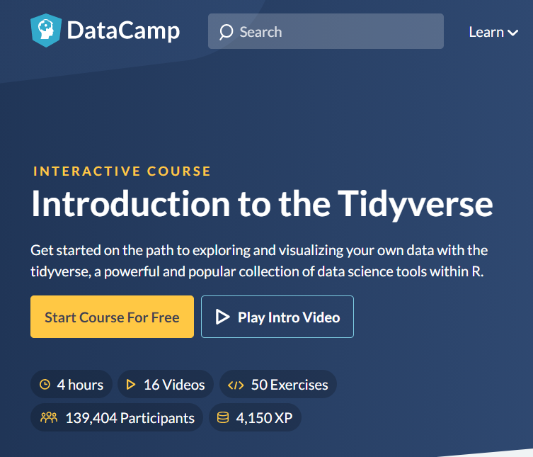
https://r4ds.had.co.nz/

Slide 34
https://r4ds.had.co.nz/

